Slide 1

Faculty of Engineering
ENGG1000 Engineering Design and Innovation
Semester 1 2018
Dr. Ang Liu
Email: ang.liu@unsw.edu.au
Week 03:
Engineering Design Process
Problem Definition

Slide 2

What is this？
Use the verb to define the problem an artifact is intended to solve !

Slide 3
Define an engineering design problem
Given the customer need of “cure cancer”
It can be formulated as a biological problem
Design an experiment to understand how cancer is developed
It can be formulated as a pharmaceutical problem
Design a new drug to detain the cancer development
It can be formulated as a policy making problem
Design an insurance policy to reduce the cost of treatment
It can be formulated as an engineering problem
Design a scanning machine to identify, image stage-1 cancers
Design a big-data platform to analyse risk of developing cancer
Design a medical device to remove cancer completely

Slide 4
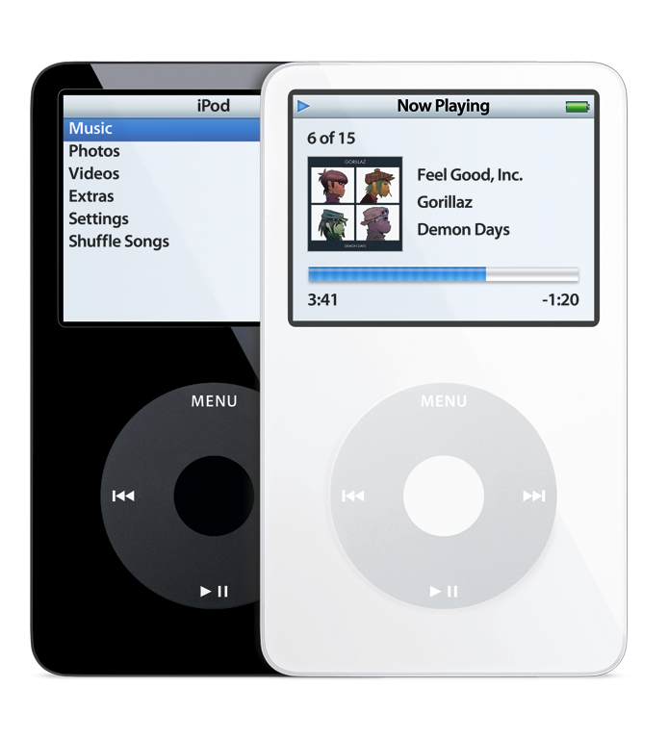
Values of problem definition
Design a MP3 player?
Storage capacity
Upload speed
Sound quality
Size and weight
Battery life
Carry 1,000 songs in pocket?
Where to find and download 1,000 songs?
How to organize the 1,000 songs?
How to pay for the 1,000 songs

Slide 5


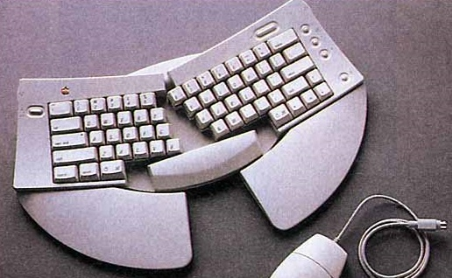
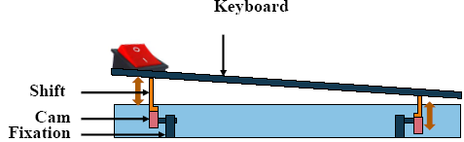
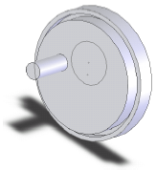
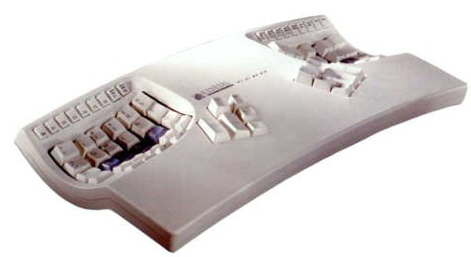
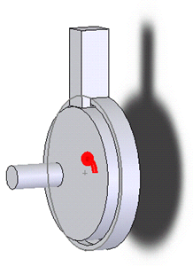
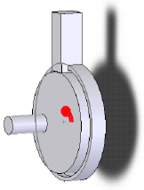

Good problem definition leads to innovation
Adjust towards the most
comfortable position
Repeated Stress Injury
Interrupt repetition of
the same position
The floating keyboard

Slide 6
The Design Process
Problem Definition
Formulating the problem to identify aspects of the task to be investigated.
Produce a problem statement.
Concept Generation
Generate a range of design concepts for solving the problem
Evaluation of the Design
Critique and evaluate the proposed concepts.
Select the best solution
Detailed design and refinement.
Implementation – building and testing.

Slide 7
Dym’s Model
From the definition:
…. stated
objectives … and
constraints.
Systematic …
generation then
evaluation ….
Client’s Problem Statement
Problem Definition
Conceptual Design
Preliminary Design
Detailed Design
Documentation for Final Design
Design Communication

Slide 8
Translate the Client’s problem statement into
your problem definition.
Remember:
A bad problem statement will limit your choices in finding a good solution.
To that end, we need solution-independence.
Client’s Problem Statement
Problem Definition
Conceptual Design
Preliminary Design
Detailed Design
Documentation for Final Design
Design Communication
Problem definition is important for the assessments of problem definition, design proposal and design presentation.

Slide 9
Elucidating the Design Problem:
From the Client’s Request through to the Generation of Concepts

Slide 10
Phase 1: problem definition
Client’s Request
OBJECTIVES
Phase 1:
Problem
Definition
Objective
Tree
PCC
Problem Statement
Constraints
Establish
METRICS
“Short List” of Concepts

Slide 11
Phase 1: problem definition
Dym’s four parts:
1.1 Clarify Objectives
1.2 Establish Metrics for Objectives
1.3 Identify Constraints
1.4 Revise the Client’s Problem Statement
Then…..
1.5 Identify the Functions and Requirements
→ Articulate the Problem Definition in Engineering terms. But not today!

Slide 12
1.1 Clarify the design objectives
Gathering information is the key:
Target customers vs relevant stakeholders
Customer voices: surveys, focus groups, formal interviews, etc.
Lead users in the field
The Objective Tree may be a useful tool for you.

Slide 13
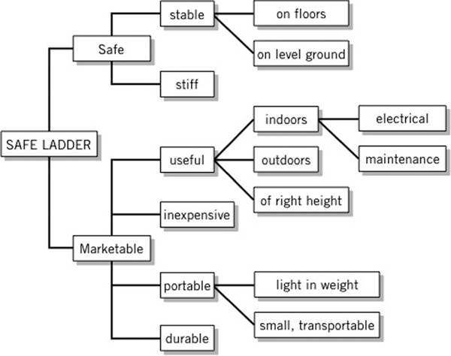
An Example from Dym - “Design a Safe Ladder”
An “Objective Tree” (Dym, Figure 4.1), representing goals for our Device.
Remember that we need solution-independence

Slide 14

Who are the real customers?

Slide 15
1.2 Establish a set of metrics
“First and foremost, a metric should actually measure the objective that the design is supposed to meet.”
– Dym
Decide what to measure, with respect to the objectives.
Determine the appropriate units (generic categories can be okay).
Make sure the metrics are repeatable and their value unambiguous.
The metrics, like the Objectives must be solution-independent.

Slide 16
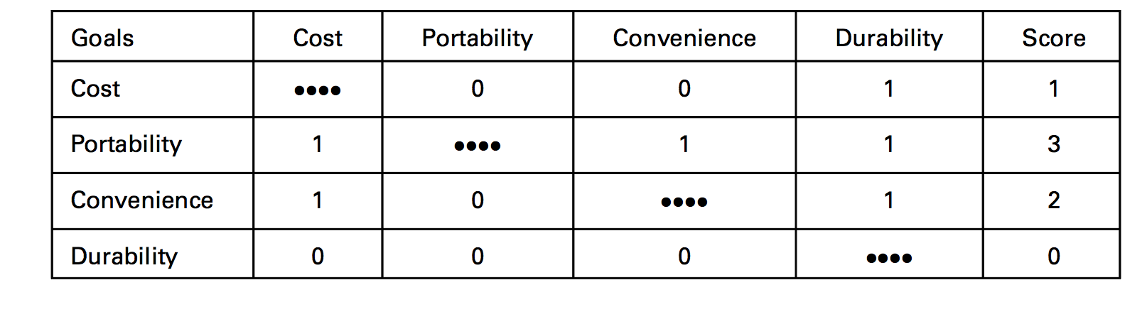
A Pairwise Comparison Chart as a tool for Prioritising Objectives For the ladder example from Dym:
Value of 1 - Row objective preferred over column objective
Value of 0 – Column objective preferred over row objective
Value of 0.5 – Objectives valued equally
A “PCC” (Dym, Table 4.4), ranking the importance of the goals for our Device.
Each objective should come from a common node on the Objective Tree.
Remember that we do not weight or scale the objectives…..yet.

Slide 17
Now consider the Pairwise Comparison Chart (PCC) as an aid in prioritising the Objectives.

Slide 18
PCC for the formula car
Objectives | Fast | Reliable | Economic | Safe | Score
Fast | - | 1 | 1 | 0 | 2
Reliable | 0 | - | 1 | 0 | 1
Economic | 0 | 0 | - | 0 | 0
Safe | 1 | 1 | 1 | - | 3
So our Objectives and associated Metrics for this example in order of importance are:
Safe (deceleration force in the event of accident, g)
Fast (lap time, s)
Reliable (distance between re-builds, km)
Frugal (fuel consumption, L/100km)

Slide 19

1.3 Identifying Constraints
These are the common constraints
Cost
Schedule
Government regulation
Weight
Dimension
From the Client, the constraints may:
Be hard or fixed (e.g. size).
Be soft or negotiable (these need to be established).
Define Limits (e.g. upper/lower bounds of a parameter).
Be quantitative (i.e. have a number attached).
Be qualitative (e.g. could be a taste or feel or look).

Slide 20
Constraints versus Objectives?
Weight
Dimensions
length
width
Engine Size
Fuel tank capacity
Material
Wheel size

Slide 21
1.4 Revise the Client’s Problem Statement
Aim for a single sentence….or at least a single “paragraph”.
Try to keep it simple (minimum number of words).
It must be clear and explicit.
It must be sufficiently broad (so as not to overly constrain your potential solutions).
(Dym: Write it in terms of a function (or functions) → But we won’t look at Functions until Phase 2).

Slide 22
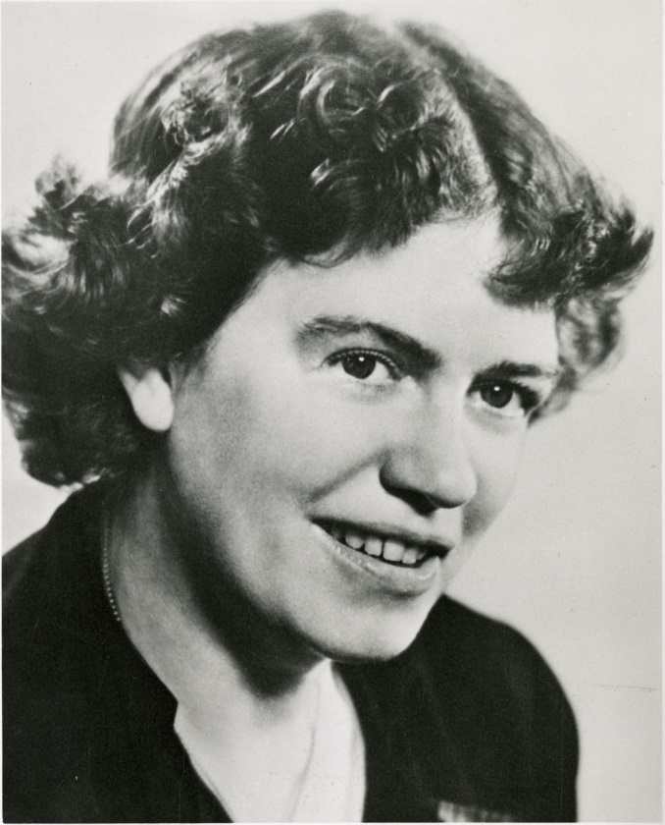

“What people say, what people do, and
what they say they do are entirely different!”
“Customers don't know what they want until you show them”

Slide 23
Having Defined the Problem, now Develop a Problem Statement
Example: A Client’s Report:
“In a hot and poor country, food perishes too quickly”.
A new Engineer’s original attempt at a Problem Statement:
“Design and build a machine that keeps food fresh and cold for under $100”.
What is wrong with this statement?
It’s too narrow and specific.

Slide 24


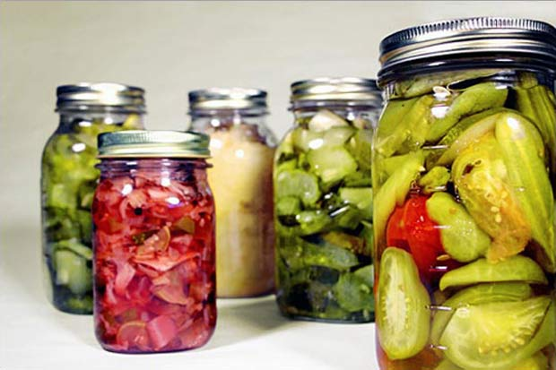
“In a hot and poor country, food perishes too quickly”.
→ “Design and build a machine that keeps food fresh and cold for under $100”.
Why does it have to be a machine?
Is cold necessary?
What do we mean by fresh?
How quick is quick?
Why $100?
“Design a system to preserve food for a long period of time.

Slide 25
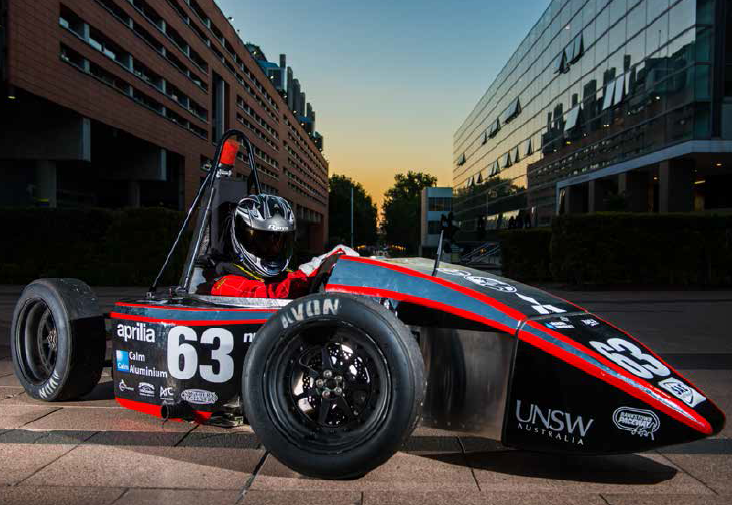
Examples of Problem Statements for Formula SAE
“Design and construct a racing car.”

Slide 26
Examples of Problem Statements for Formula SAE
“Design and construct a racing car.”
Vague.
“Design and construct a racing car that meets specific client controls concerning speed and cost.”
Vague.
“Design and construct a vehicle for competition that accelerates as quickly as possible in any required direction. Performance must be maximised and cost minimised whilst adhering to the rules regarding size and safety.”
Longer but at least has reasonable breadth whilst ensuring that the rules are acknowledged.
….Think about incorporating the objectives

Slide 27
Problem Definition → Problem Statement
Problem definition is the process by which you arrive at a concrete Problem Statement.
Be careful:
One person’s problem statement is another person’s conceptual design.
How do I write a Problem Statement?
Think! Use tools as need-be:
Listing objectives and constraints (Dym, p.40).
Statement – Restatement Method (Voland, p. 92).

Slide 28
Dym’s four parts of Defining the Problem:
1.1 Clarify Objectives.
1.2 Establish Metrics for Objectives.
1.3 Identify Constraints.
1.4 Revise the Client’s Problem Statement.
Then…..
1.5 Identify the Functions and Requirements
→ Articulate the Problem Definition in Engineering terms.
Leave this last step alone for a while.
For now, concentrate on understanding the problem.

Slide 29
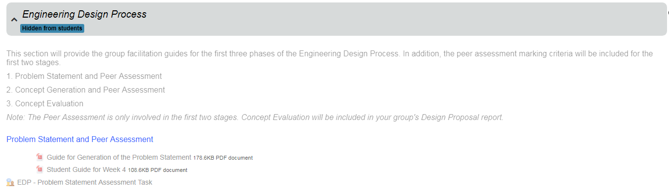
Read the instructions on Moodle carefully! Be prepared for the assessment in Week 4

Slide 30
Project Bionic Hand - Announcements
Technical Stream Enrolment:
Enrol by 10pm tonight on Moodle!
Aim for a diversity within your team
Technical Streams begin on Thursday at 2pm
Biomedical - Red Centre M032
Mechanical – Chem Sci M17
Electrical – Lecture room TBC (see Moodle)
Mentor Meeting
Monday 4pm or Thursday 4pm this week. See allocation on Moodle
Complete your Team Contract and up-load it to Moodle
Next week – Problem Statement Activity
Next Monday be here for the Conceptual Design Lecture

Slide 31
Project DELTA- Announcements
Technical Stream Enrolment:
Enrol by 10pm tonight on Moodle!
Aim for a diversity within your team
Technical Streams begin on Thursday at 2pm
Mechanical – Chem Sci M17
Electrical – Lecture room TBC (see Moodle)
Mentor Meeting
Team 01-23: Monday 4pm-5pm
Team 24-47: Thursday 4pm-5pm. See allocation on Moodle
Next week – Problem Statement Activity
Next Monday be here for the Conceptual Design Lecture

